Slide 1
ROADMAP TOWARDS AN EFFECTIVE REGULATORY REGIME ON DIGITAL FINANCIAL SERVICES (DFS)- CASE OF GHANA
BY
Samuel K. Agyekum,
(Dep. Manager, NCA & Vice Chairman, ITU-T SG 12 AFR)

Slide 2
Outline
Presentation Outline
Growth Indicators & Trends on DFS
Policy Direction on DFS
Regulatory Framework- as Key Enabler
Stakeholder Consultations & Outcomes
Key Highlights of the Payment Systems Act 2019
Roles of Relevant Implementing Institutions
Levels/Nature of Collaboration Required
Conclusion & Way Forward

Slide 3
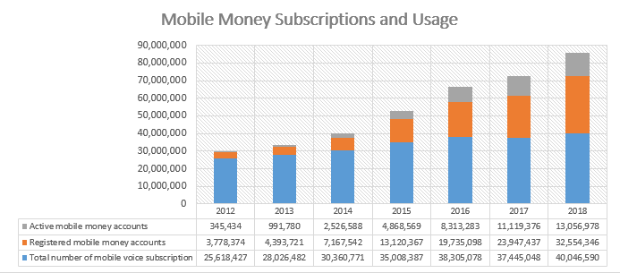
Outline
Growth Indicators and Trends on DFS
Source: Bank of Ghana, Payment Systems Department

Slide 4
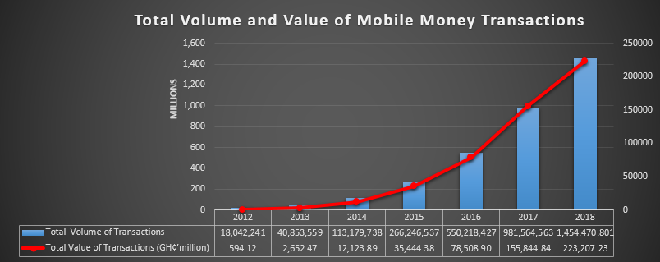

Outline
Growth Indicators and Trends on DFS
Source: Bank of Ghana, Payment Systems Department, 2019

Slide 5
Policy Direction on DFS
By 2020, Ghana seeks to have a resilient, inclusive and innovative DFS ecosystem where:
All Ghanaians have access to a large and broad range of quality and affordable digital financial services – including payment, credit, savings, insurance, and investment – that meet their needs;
Businesses and Government have achieved greater transparency and efficiency to contribute to the economic growth of the nation; and
Payment flows have been digitized and formalized, thereby shrinking the informal economy, increasing Government revenues, and making monetary policies more effective.
(Source: Ghana Ministry of Finance/Draft DFS policy document, Jan 2018)

Slide 6
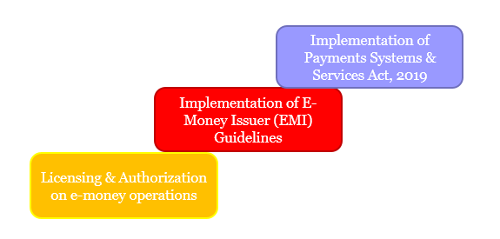
“
Regulatory Framework- as Key Enabler
The Bank of Ghana (BoG’s) regulatory roadmap on Payment Systems industry is as per below:

Slide 7
“
Regulatory Framework- as Key Enabler
A law on DFS would facilitate MoF’s policy implementation on DFS as follows :
Promote convenient, efficient and safe retail payment and funds transfer mechanisms;
Streamline and strengthen licensing procedures, governance arrangements, oversight, consumer protection and anti-money laundering procedures;
Promote the availability and acceptance of electronic money whilst ensuring the necessary safeguards and controls are put in place to mitigate the risks;
Assist to reduce barriers to entry into the payment services space, increase competition and promote innovations.

Slide 8
“
Stakeholder Consultations & Outcomes
S/N | Workshop Title/date | Target Participants | Key Outcomes
1 | Final Workshop on the Payment Systems and Services Bill held from, August 2017 | BoG, NCA, MNOs, Fintechs, Banks, AG, MoF, SEC | Attorney-General’s department to re-draft the Payment Services and Systems Bill to reflect all amendments made by stakeholders; after which the revised copy should be submitted to the Bank of Ghana (BoG)
 |  |  | Payment Services Advisory Committee to be constituted by the Governor, Bank of Ghana to provide advisory services on guidelines for the operationalization of e-payment systems in Ghana.
2 | DFS Supervision Workshop, October 2017 | BoG, NCA, MoF, SEC, NIC, GHIPSS | A collaborative DFS supervision regime to be adopted in Ghana using the I-SIP framework model.
3 | Mobile Money Interoperability (MMI) Project Workshop, November, 2017 | GHIPSS, BoG, NCA, MoF, SEC, NIC | GHIPSS to communicate to the Vice President and the public that testing of MMI in Ghana has started and expected to be fully launched by June 2018
4 | Meeting of the Payment Systems & Advisory Committee, August 2018 | BOG, NCA, SEC, NIC, MOF | Bank of Ghana (BoG) to lead capacity-building activities on Blockchain and QR-code technology products in order to harness their positive influences on payment systems in Ghana.

Slide 9
“
Key Highlights of the Payment Systems & Services Act, 2019 (Act 987)
Payment Systems and Services Bill was submitted to Ghana’s parliament in 2018 and passed into law in May 2019. Below constitute the thematic areas in the ACT;
Licensing and Authorization of Payment Service Providers and Electronic Money Issuers
Payment Systems, Payment Instruments and Electronic Transmission
Governance Arrangements
Technology, Security and Controls
Consumer Protection
Oversight, Reporting and Sanctions

Slide 10
Roles of Relevant Implementing Institutions
Regulatory Body | Roles/Interventions | Supporting Provisions per Act 987 & Other Laws
National Communications Authority (NCA) | To regulate the electronic communications services aspect of DFS, particularly on the issuance of VAS licenses. | Sections 20 and 45 of Act 987 & Electronic Communications Act, 2008.
National Information Technology Authority (NITA) | To regulate electronic transactions by supervising national infrastructure payment platforms. | Sections 4(3b) of Act 987 & Electronic Transactions Act, 2008
Bank of Ghana (BoG) | To regulate and supervise EMIs and PSPs on all matters relating licensing/authorization, reporting | Sections 7- 44 of Act 987 & Bank of Ghana Act, 2002
Data Protection Commission (DPC) | To supervise and enforce national data protection laws on payment systems | Section 34(6) of Act 987, Data Protection Act, 2012

Slide 11
“
Levels/Nature of Collaboration Required
In 2016, a Memorandum of Understanding (MoU) was signed between the Bank of Ghana and the National Communications Authority (NCA).
Following the passing into law of the Payment Systems and Services Bill, an Inter-sectorial MoU is expected to be implemented in accordance with Act 987 together with other adjunct laws, where applicable.
The MoU should be expanded to cover the following key areas:
Consumer Protection
Cybersecurity/Fraud Prevention
Stability of Infrastructure/payment platforms

Slide 12
Conclusion & Way Forward
The Central bank and Telecom Regulator are encouraged to conduct a lot more consumer sensitization campaigns on DFS to clarify their regulatory roles in the consumer protection domain of DFS supervision. The essence being to save these institutions regulatory cost as well as improve the turnaround time in addressing consumer concerns.
A culture of continual capacity building to bridge knowledge and skills gaps on DFS regulation is highly encouraged. This may be achieved through training workshops by DFS consultants, boot camps, and industrial working-visits.
Implementation of periodic stakeholder consultation programme on areas of security/risk management, consumer protection, innovation and competition.
Introduction of a national competition law and authority.

Slide 13

Thank You for your time & attention

